Slide 1
Group Purpose Workshop Aligning Our Aspirations with the Group Purpose
Roy Vincent M. Paring

Slide 2
A Journey of Reflection and Growth
Discovering Aspirations that Resonate with Fujifilm Group’s Purpose
Welcome to your personal reflection journey!
This workbook is designed to help you explore, reflect, and visualize your life story as a foundation for discovering your aspirations which resonate with Fujifilm Group’s Purpose. By engaging in this process, you’ll gain a deeper understanding of your personal impact, values, and the future you want to create.
This workbook includes:
Optional readings are provided to support your understanding and assist with completing your prework
Please complete the prework before the workshop. As it involves self-reflection and thoughtful consideration, we encourage you to start early and avoid leaving it until the last minute
Activities that will be done during the workshop
Reference
Prework
Workshop

Slide 3
Understanding the Layers of Identity
Reference
Identity is a multi-dimensional concept shaped by various interconnected layers. These layers interact and evolve over time, influenced by internal factors and external experiences:
Core Identity: The fundamental layer that encompasses an individual's core values, beliefs, and traits. It represents our true self and is stable over time.
Physical Identity: Represents our body, appearance, and physical attributes such as age, gender, and race. It also includes health and fitness levels.
Cultural Identity: Shaped by cultural background, including traditions, language, and community practices. This layer influences how we view the world and interact with others.
Professional Identity: Defined by our career, job roles, skills, and professional achievements. It influences how we perceive our purpose in the workplace.
Social Identity: The roles we hold in society, shaped by relationships with family, friends, colleagues, and communities. It includes gender, age, social class, and professional roles.
Digital Identity: Shaped by our presence and interactions online, such as social media profiles and digital behavior, influencing how we are seen in virtual spaces.
Experiential Identity: Focuses on individual experiences, interests, and preferences. It reflects our personal history, passions, and how we view ourselves.
These layers are interconnected and together shape our overall sense of self, constantly evolving as we navigate different stages and environments in life.

Slide 4
Reference
Understanding Motivation
Motivation is the driving force that fuels our actions, decisions, and behaviors. It can be influenced by both internal desires and external factors. Broadly, motivation can be categorized into two types: intrinsic motivation, which comes from within, and extrinsic motivation, which is driven by external rewards or pressures. Both types play a role in shaping who we are.
Intrinsic Motivation:
Personal Fulfillment: Driven by enjoyment or meaning in the activity itself.
Sense of Purpose: Motivation from aligning actions with core values.
Autonomy: Desire to act freely and independently.
Mastery: Motivation to improve and learn new skills.
Enjoyment: Driven by the pleasure of the activity.
Extrinsic Motivation:
Rewards & Recognition: External incentives like money, praise, or promotions.
External Pressure: Motivation from deadlines, expectations, or avoiding punishment.
Social Comparison: Desire to outperform others or gain status.
Obligations: Driven by societal or familial expectations.
Tangible Outcomes: Motivated by tangible rewards, such as financial gain.

Slide 5
Understanding Passion vs. Motivation
Reference
Passion and motivation are closely related but distinct concepts. Passion is the intense, emotional drive that fuels our enthusiasm and commitment to a particular activity or cause, often arising from deep personal values, emotional connections, and a sense of purpose. Motivation, on the other hand, is the broader psychological force that initiates and sustains goal-oriented behavior, which can be driven by both intrinsic factors (personal fulfillment, desire for mastery) and extrinsic factors (rewards, social pressure). While passion is often the spark that ignites motivation, motivation is the ongoing force that keeps us working towards our goals, whether fueled by passion or external rewards.
Internal Drives and Self-Connection:
Personal Values and Beliefs: Passion arises when actions align with core values or a sense of purpose
Identity and Self-Expression: Engaging in activities that reflect our authentic self
Purpose and Meaning: Pursuits that give life meaning, such as career goals or family contributions
Ambition and Desire for Achievement: The drive to reach specific goals or succeed
Emotional and Social Influences:
Emotional Connections: Deep emotional bonds with people, places, or memories
Social Influence and Support: Passion growing stronger through encouragement from others or shared goals
Inspiration: Exposure to inspiring individuals, stories, or works that spark emotional responses
Novelty and Growth:
Novelty and Exploration: New experiences and challenges that evoke excitement and passion.
Past Experiences: Positive memories of past successes or milestones that reignite passion.

Slide 6
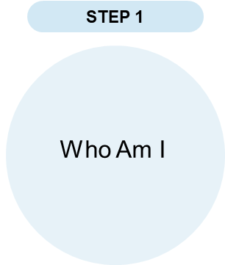
Prework
Creation of My +STORY – Present
PRESENT: WHO I AM TODAY
Think about your current self. Use the space below to describe the key aspects of who you are today.
PERSONALLY, and PROFESSIONALLY:
What are the key elements of my identity at home & at work?
What motivates me?
Personally, I am curious, creative, and passionate about continuous learning. I enjoy exploring technology and finding solutions to problems. I value discipline, patience, and self-improvement because I believe growth comes from experience and effort.
Professionally, I am focused on improving my technical skills, especially in web development and system design. I enjoy building projects, learning new technologies, and challenging myself to improve every day. I work well independently and with a team, and I always aim to produce quality work.
What motivates me is my ambition to become successful in the tech industry and create systems that can help people and organizations. My family, future goals, and passion for technology continue to inspire me to work hard and never stop learning.

Slide 7
Prework
Creation of My +STORY – Past
PAST: LIFE EXPERIENCES THAT MADE ME WHO I AM (PERSONAL)
Reflect on significant events and experiences from your life. Use the space below to write about moments that shaped your character and values. What were some of the highs (times of confidence and growth) and lows (times of self-doubt and/or transition) you experienced during childhood, young adulthood and in your recent past?
Age Range | HIGHS | LOWS
0 to10 | Grew up learning the importance of family, respect, and discipline. Enjoyed discovering new things and developing curiosity through school and hobbies. Built happy memories with family and friends. | Experienced moments of shyness and fear of failure as a child. Sometimes struggled with confidence and understanding my own strengths.
10 to 19 | Developed interest in technology, computers, and problem-solving. Improved communication skills, built friendships, and became more independent during school years. Learned valuable lessons through academic and personal challenges. | Faced pressure about academics, future goals, and self-doubt. Experienced stress during transitions and moments where I questioned my abilities and direction in life.
20 to 29 | Became more focused on personal growth and career development. Improved technical skills in web development and systems. Learned to become more responsible, adaptable, and goal-oriented. Gained confidence through real-world experiences and challenges. | Experienced stress, uncertainty, and pressure while balancing career goals and responsibilities. Faced challenges in handling failures, expectations, and finding stability in life and work.
30 to 39
40 to 49
50 onward

Slide 8
Prework
Creation of My +STORY – Past
PAST: LIFE EXPERIENCES THAT MADE ME WHO I AM (PROFESSIONAL)
Reflect on significant events and experiences from your professional life. Use the space below to write about highs and lows that shaped you into the professional you are today.
Age Range | HIGHS | LOWS
20s | In my 20s, I began building the foundation of my professional life and discovering the career path I truly want to pursue. I developed my skills in technology and web development, gained real-world experiences, and learned how to handle responsibilities more seriously. Every project, challenge, and opportunity helped me grow not only professionally but also personally. I became more motivated to improve myself, contribute meaningful work, and create a better future for my family and myself. | My professional journey in my 20s has also been filled with uncertainty, pressure, and self-doubt. There were moments when I felt inexperienced and questioned whether I was good enough to succeed. I experienced stress from balancing expectations, career goals, and personal responsibilities. Failures, mistakes, and setbacks sometimes affected my confidence, but they also taught me resilience, patience, and the importance of continuing to learn despite difficulties.
30s
40s
50s onward

Slide 9
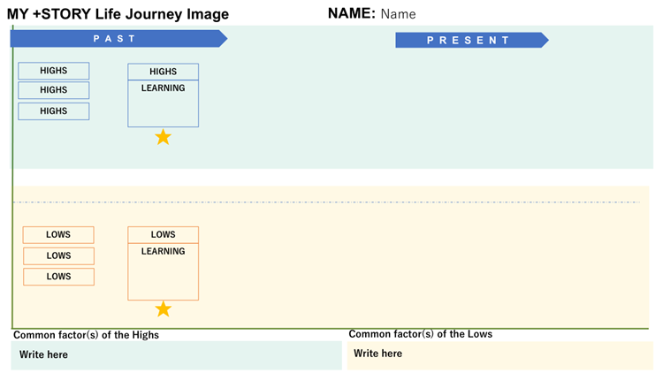
Prework
Creation of My +STORY – Life Journey Image
Now that you have reflected on your PRESENT and PAST, create an image of your +STORY Life Journey highlighting key moments (both high points and low/challenges) that have shaped who you are today.
PRESENT refers to your journey when you start your tenure with Fujifilm.
2
Adjust the lengths of indicators where necessary
1
3
List your High and Low events from past and present
Describe your insights / learnings from at least one High and Low event
4
Describe the common factors you have identified from your High and Low events

Slide 10
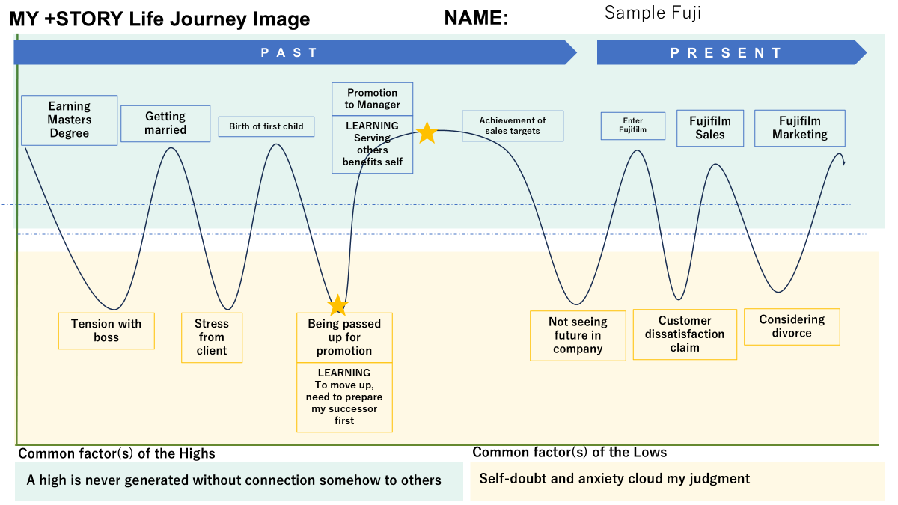
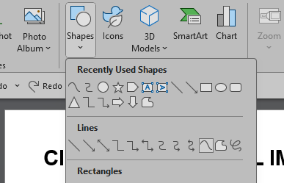
Prework
Creation of My +STORY – Life Journey Image
5
Draw a journey curve connecting the Highs and Lows
Go to "Insert" Tab: Click on "Shapes" in the toolbar.
Select "Curve" Shape: In the dropdown menu, find the "Curve" tool (usually under "Lines").
Draw Your Life Journey Image Line: (1) Click once on the timeline to start your line. (2) Click again at each point where your experience shifts (up for positive experiences, down for challenging ones). (3) To complete the line, double-click or connect back to the end point.
Print a copy of your MY +STORY Life Journey Image for your discussion group during the workshop.

Slide 11
Reference

Slide 12
Prework
MY +STORY Life Journey
Name:
PAST
PRESENT
Common factor(s) of the Highs
Common factor(s) of the Lows

Slide 13
Reference
Examples of Impact
Having a positive impact on others means influencing or contributing to their well-being, growth, happiness, or success in a meaningful way. It involves actions, attitudes, or words that uplift, support, or inspire others. Here are examples of what this could look like in different contexts:
In the Workplace
1. Mentorship: Guiding a junior colleague by sharing knowledge and providing feedback that helps them develop skills and confidence.
2. Creating an Inclusive Environment: Encouraging diverse perspectives and ensuring everyone feels valued.
In the Community
1. Volunteerism: Contributing time or resources to help those in need.
2. Environmental Stewardship: Encouraging sustainable practices that benefit others in the long term.
In Personal Relationships
1. Emotional Support: Being there for someone during difficult times and offering encouragement or a listening ear.
2. Celebrating Achievements: Recognizing and cheering on others' successes, big or small.
In Everyday Life
1. Acts of Kindness: Performing small gestures that brighten someone’s day.
2. Inspiring Change: Motivating others to improve their lives or pursue their dreams.
Having a positive impact is not about grand gestures but about being mindful of how your actions and words influence others. It’s about creating ripples of good that contribute to a better environment for those around you AND also provide you with the satisfaction that comes from interacting with others.

Slide 14
Prework
The IMPACT I Want To Create - Future
FUTURE: THE IMPACT I WANT TO CREATE
What impact do you want to have on others ?
What do you want to do more to make a difference?
In the future, I want to create a positive impact by inspiring others through my work, attitude, and perseverance. I want to be someone who encourages people to continue learning, improving themselves, and believing in their abilities even during difficult times. I hope to use my knowledge and skills in technology to create systems and solutions that can make work easier, improve people’s experiences, and contribute meaningful value to organizations and communities.
Beyond professional success, I want to make a difference by becoming a person that has integrity, and compassion. I want to support my family, help others whenever I can, and become someone that people can trust and depend on. My goal is not only to achieve personal success but also to inspire growth, positivity, and motivation in the lives of others.
As I continue to grow, I want to challenge myself to become better each day, embrace failures as lessons, and use every experience to create a meaningful and lasting impact on the people around me.

Slide 15

Reference
Understand Fujifilm Group’s History
https://holdings.fujifilm.com/special/90th/en/history/

Slide 16
Your Prework ends here
Please print and bring a copy of your workbook for the workshop
We look forward to seeing you at the workshop

Slide 17
Workshop
Understanding Who am I?
Reflect on your identity and your experiences to clarify your impact.
Present
Who am I today and what I want in my life?
Past
What are my learnings and abilities that I want to maximize?
Future
What is the impact I want to have on others?
Today, I see myself as a person who is continuously growing and striving to become better both personally and professionally. I want a life that is meaningful, stable, and successful. not only for myself but also for the people who believe in and support me. I aim to become someone who is responsible, skilled, and capable of making a positive contribution through my work and actions.
From my past experiences, I learned the importance of perseverance, patience, and self-improvement. Challenges, failures, and moments of self-doubt taught me to become stronger and more resilient. I discovered my passion for technology, problem-solving, and continuous learning, and these are the abilities I want to maximize as I continue building my future and career.
In the future, I want to create an impact by inspiring others to never stop learning and believing in themselves despite difficulties. I hope to use my skills and experiences to create meaningful solutions, help others grow, and contribute positively to my workplace and community. More than success, I want to be remembered as someone who worked hard, stayed humble, and made a difference in the lives of others.

Slide 18
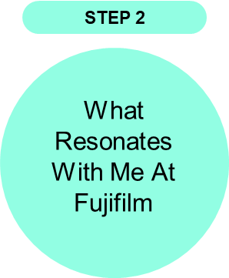
Workshop
Identifying My RESONANCE with Fujifilm
Having reviewed Fujifilm Group’s commitment
What is the overlap between the impact you want to make (step 1) and the commitments of Fujifilm?
What resonates with me most about Fujifilm’s commitment is the focus on continuous innovation, creating value for society, and making a positive impact on people’s lives. I also believe in continuously improving myself, learning from challenges, and using my skills to contribute meaningful work that can help others and create better solutions.
My personal goal of becoming someone who grows through perseverance, responsibility, and continuous learning aligns with Fujifilm’s commitment to innovation and contribution to society. I admire how the company embraces change, adapts to challenges, and continues to evolve while maintaining its purpose and values.
I want to contribute by applying my skills, creativity, and willingness to learn in ways that support both organizational goals and the people around me. Like Fujifilm, I hope to create a positive impact through dedication, collaboration, and a mindset focused on growth and improvement.
Notes:
5mins – self

Slide 19

Workshop
Determining My ASPIRATION With Fujifilm
Determine my aspiration based on the overlap between the impact I want to make (step 1) and the commitments of Fujifilm (step 2)
My aspiration with Fujifilm is to grow into a professional who continuously learns, innovates, and contributes meaningful value to both the company and society. I aspire to strengthen my skills, especially in technology and problem-solving, while embracing challenges as opportunities for growth and improvement.
I want to become someone who not only achieves personal and professional success but also inspires others through dedication, responsibility, and perseverance. By aligning my goals with Fujifilm’s commitment to innovation and positive impact, I hope to contribute to creating efficient solutions, improving processes, and supporting a culture of continuous growth and collaboration.
In the future, I aspire to build a career where my work creates meaningful contributions, helps people, and reflects the values of integrity, adaptability, and excellence that Fujifilm represents.
Notes:
Personal action statement

